Slide 1
GROUP 2

Slide 2
Group Members
Employee Id | Name
093947 | Mohammed Asik K.
093958 | Jabbar M.A
093943 | Ajaykumar Yadav
093936 | Bhavya Shree
093979 | Priyal Potnis*
093950 | Divya Sri Thota

Slide 3
HARDWARE FUNDAMENTALS

Slide 4

Computer
It is an electronic device which takes the data,
process the data according to the instructions
and provides the output to the user.
Hardware:
Physical parts of the computer.
Eg: I/O devices, motherboard..
Software:
Set of instructions given to the computer.

Slide 5
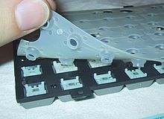
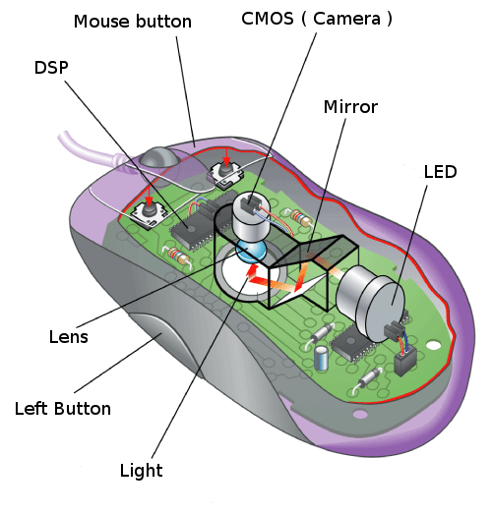
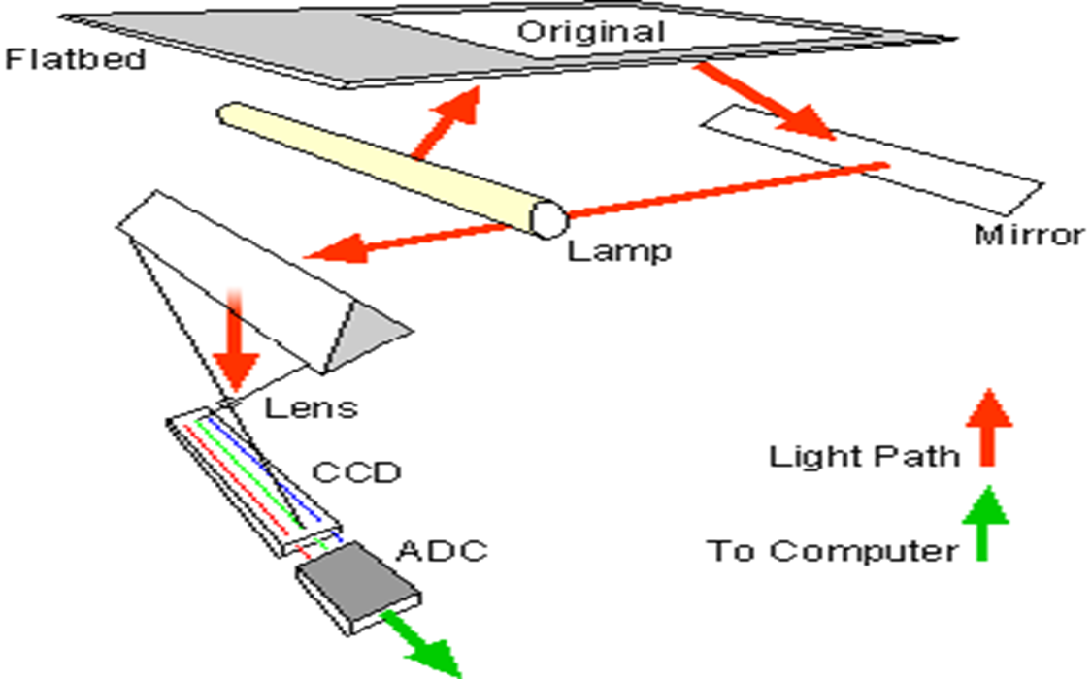

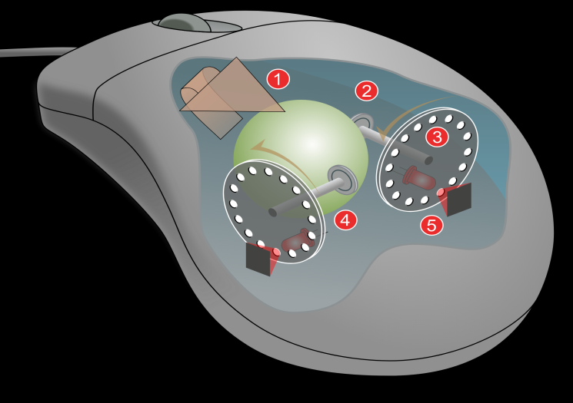
INPUT DEVICES:
An input device is any hardware device that sends data to a computer.
MEMBRANE KEYBOARD
OPTICAL MOUSE
SCANNER
MECHANICAL KEYBOARD
MECHANICAL MOUSE

Slide 6
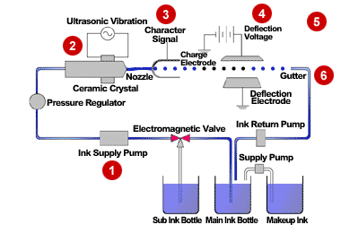
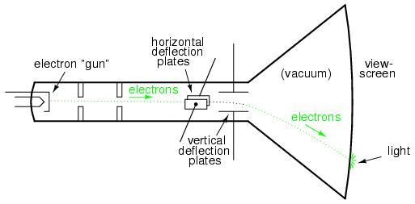
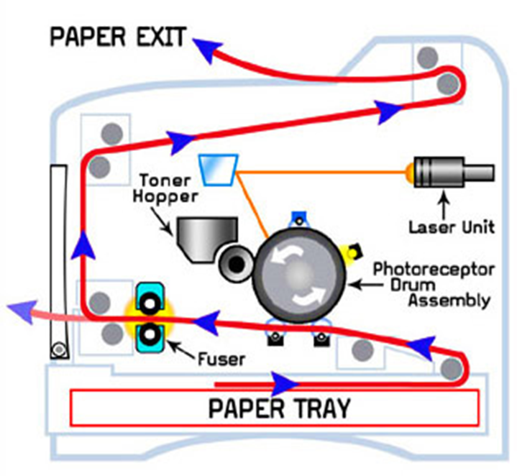
OUTPUT DEVICES:
An output device is any device used to send data
from a computer to another device or user.
INKJET PRINTER
MONITOR
LASER PRINTER

Slide 7
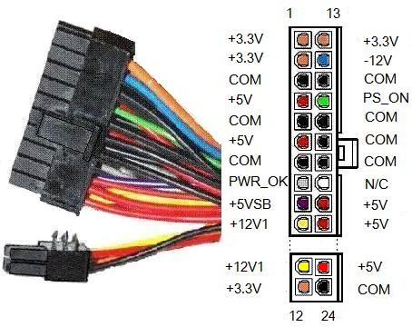
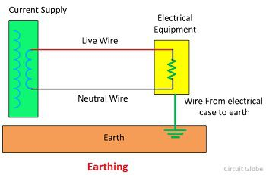
SMPS
AC INPUT
STEP DOWN TRANSFORMER
BRIDGE RECTIFIER
FILTER
VOLTAGE REGULATOR
DC INPUT
FEEDBACK
Earthing:

Slide 8
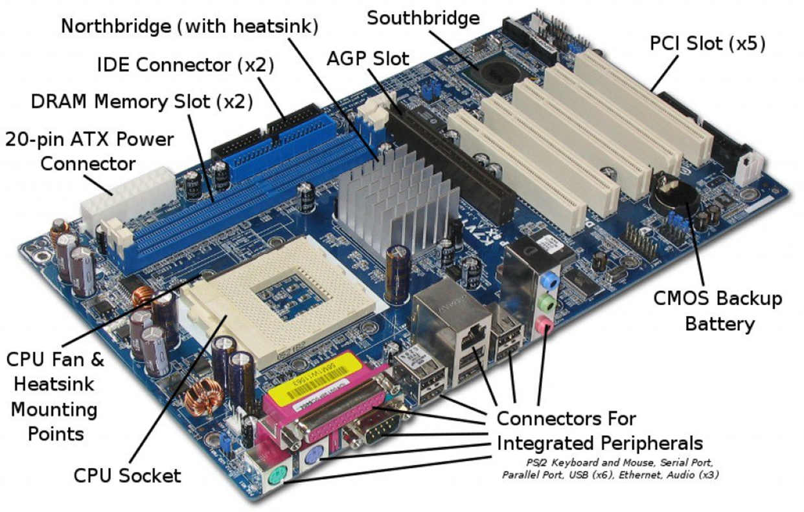
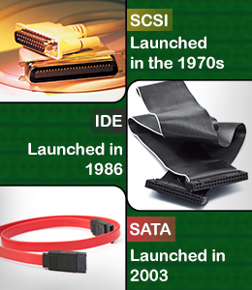
MOTHERBOARD

Slide 9
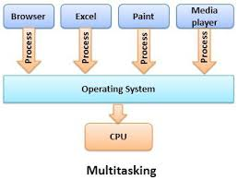
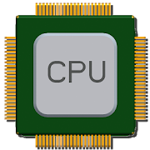
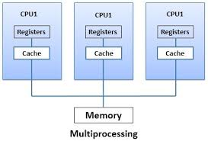
CPU architecture:
RISC
CISC
Simple
30-40 Instructions
One cycle
Parallel Execution
Multiple Register set
Complexity in compiler
Complex
100-200 Instructions
More cycles
Sequential Execution
Unique Register set
Complexity in CPU(micro-programming)

Slide 10
Memory: Memory is any physical device capable of storing information temporarily or permanently.
Memory
Primary Memory
Secondary Memory
RAM
ROM
Magnetic storage
Optical storage
PROM
EPROM
EEPROM
SRAM
DRAM
Hard disk
Magnetic tapes
CD
DVD
L1 Cache
L2 Cache
L3 Cache
DDR1
DDR2
DDR3

Slide 11
HARDWARE FUNDAMENTALS

Slide 12
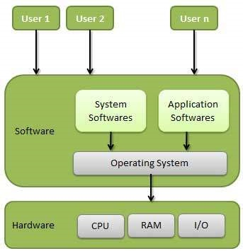
Operating system
It is an interface between user and hardware

Slide 13
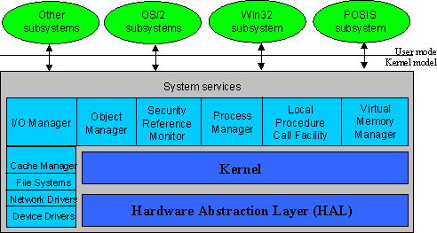
Kernel Architecture

Slide 14
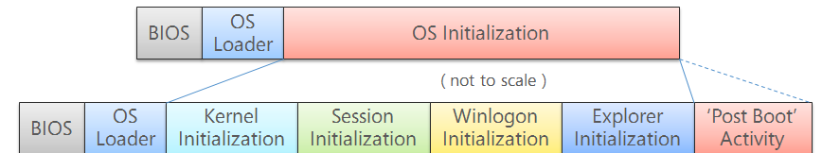
Booting Process

Slide 15
FILE SYSTEM
FAT
Partition Boot Record
FAT1
FAT2 duplicate
Root Folder
All Files
NTFS
Partition Boot Record
Master File Table
System File Data
File Area

Slide 16
PROCESS MANAGEMENT
schedule
New
created
Ready
Running
completed
Termination
Priority
time quantum
I/O completed
I/O request
resume
suspend
Wait
SuspendReady
resume
suspend
Suspend Wait
Process completed I/O
but still in suspend

Slide 17
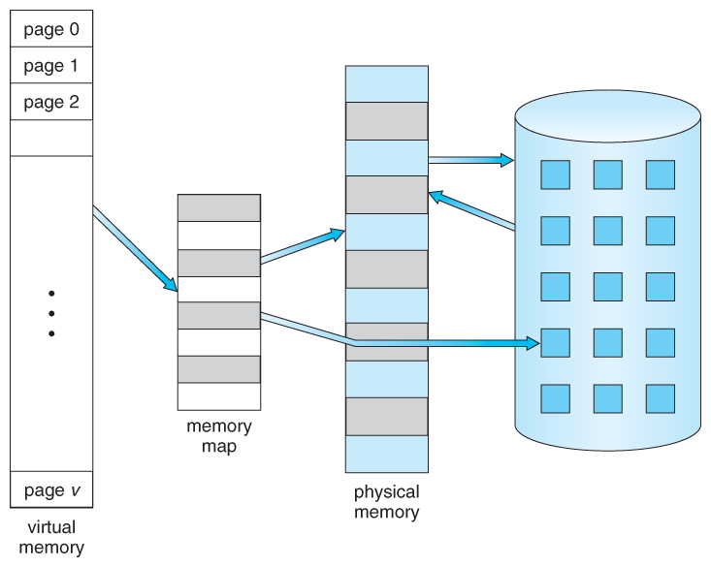
MEMORY MANAGEMENT
Physical Memory
Page in
Disk
Page table
Page Out
Disk drive

Slide 18
LINUX FUNDAMENTALS

Slide 19
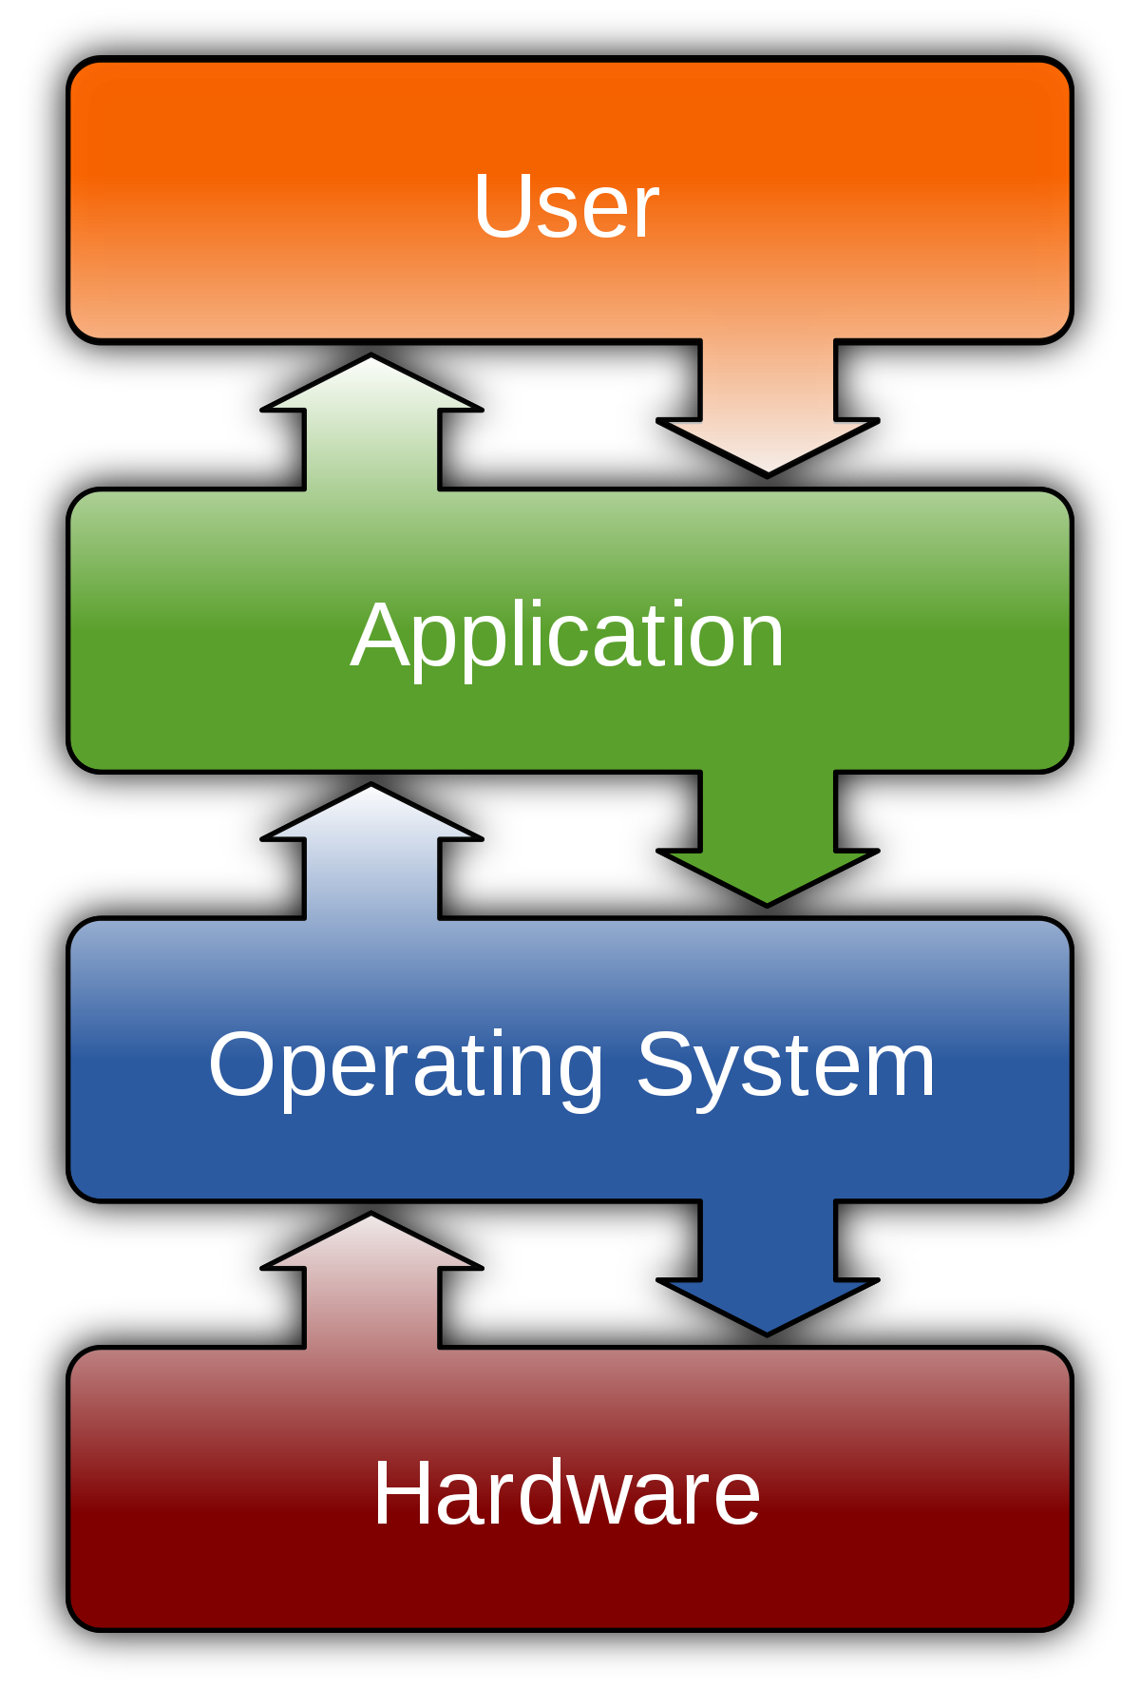



Operating System
An operating system is an integrated set of specialized programs used to manage overall resources and operations of the computer.
What if there is no operating system ?
Open Source License
GPL
ASL
MIT

Slide 20
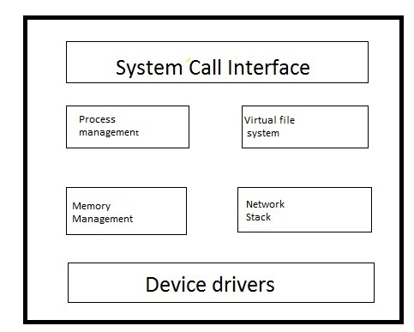

Booting Process
Kernel Subsystem
Linux kernel is composed of subsystems that communicate using procedure calls.
Booting is a start up sequence that starts the operating system of a computer when it is turned on.
BIOS
MBR
GRUB
KERNEL
INIT
RUN LEVEL
Power on
Login
INIT
/etc/inittab file to decide the Linux run level
Init identifies the default initlevel from /etc/inittab
RUNLEVEL
System executes the default runlevel
Executes /etc/rc.d/rc*.d/ programs
KERNEL
Mounts the root file system
executes the /sbin/init program
initrd is used by kernel as temporary root file system
MBR
Stands for Master Boot Record
Located in 1st sector of bootable device
Contains information of boot loader
GRUB
Stands for Grand Unified Bootloader
Stores the Kernel image
Located in /boot/grub/grub.conf
BIOS
Stands for Basic Input Output System
Performs POST method ( Power On Self Test)
Checks system integrity

Slide 21
Booting Process
Booting is a start up sequence that starts the operating system of a computer when it is turned on.
BIOS
MBR
GRUB
KERNEL
INIT
RUN LEVEL
Power on
Login
INIT
/etc/inittab file to decide the Linux run level
Init identifies the default initlevel from /etc/inittab
RUNLEVEL
System executes the default runlevel
Executes /etc/rc.d/rc*.d/ programs
KERNEL
Mounts the root file system
executes the /sbin/init program
initrd is used by kernel as temporary root file system
MBR
Stands for Master Boot Record
Located in 1st sector of bootable device
Contains information of boot loader
GRUB
Stands for Grand Unified Bootloader
Stores the Kernel image
Located in /boot/grub/grub.conf
BIOS
Stands for Basic Input Output System
Performs POST method ( Power On Self Test)
Checks system integrity

Slide 22
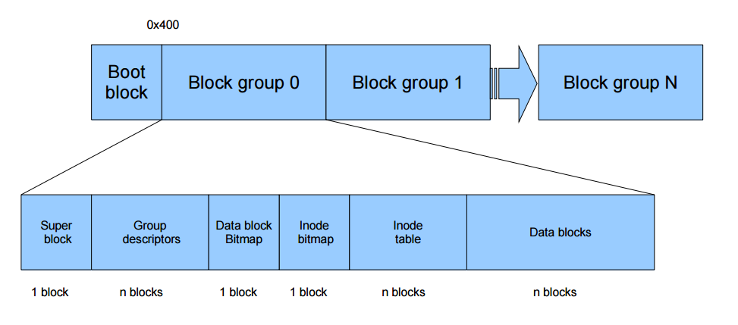
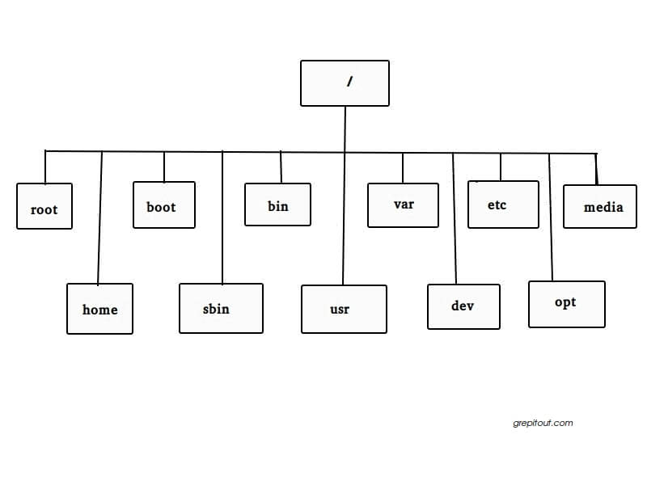
File System

Slide 23
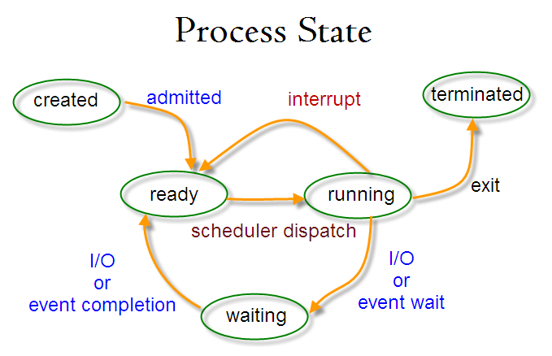
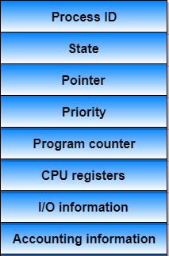

Process Scheduling
Process Management
Process scheduling is the activity of the process manager that handles the removal of the running process from the CPU and the selection of another process on the basis of a particular strategy.
Process is an instance of program execution
Types of Process
Process Control Block
Process States
Functions of Scheduler
Child Process
Daemon Process
Orphan Process
Zombie Process
Interactive Process
Batch Process
Real Time Process
CPU Utilization
Throughput
Turnaround Time
Waiting Time
Load Average
Response Time

Slide 24
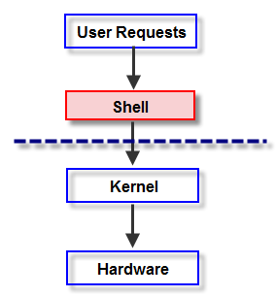
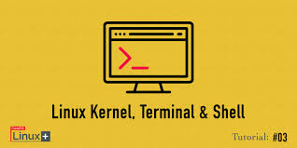
Shell
Shell is an environment in which we can run our commands, programs, and shell scripts.
It gathers input from you and executes programs based on that input.
Types of Shell:
ASH
BASH
KORN
T-SHELL
C-SHELL
Z-SHELL

Slide 25
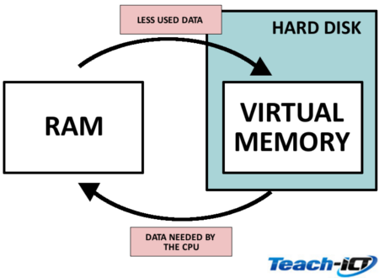
PROCESS OF PAGING
Memory Management
Memory management is the process of controlling and coordinating computer memory, assigning portions called blocks to various running programs to optimize overall system performance.
LOGICAL ADDRESS
PHYSICAL ADDRESS
PHYSICAL MEMORY
CPU
P | D
F | D
PAGE TABLE
P
P | F
P1 | F1
P2 | F2
P3 | F3
P4 | F4
P5 | F5
F

Slide 26
NETWORK FUNDAMENTALS

Slide 27
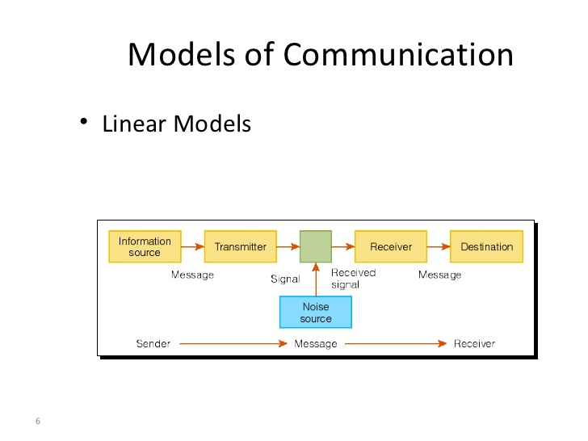
Communication
This is the process where the information is transmiited and in the other end the messages is received.
Network Characteristics
There are four types of network characteristics are there:
Fault Tolerance
Scalability
Quality of Service
Security
Components Of Communication

Slide 28
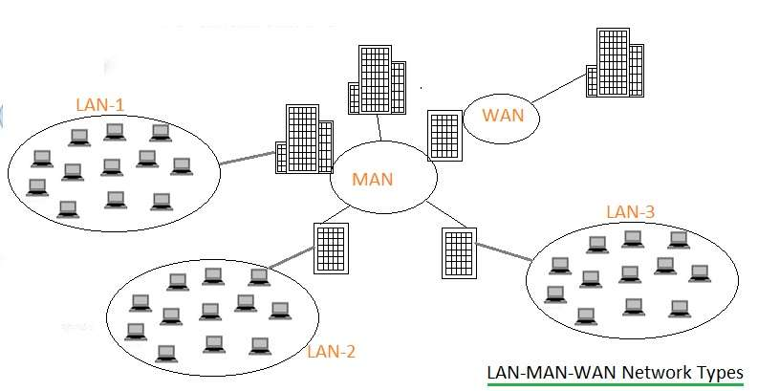
Network Types
LAN
MAN
WAN

Slide 29
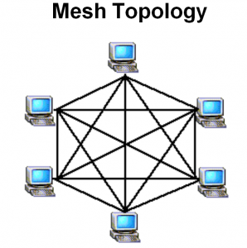
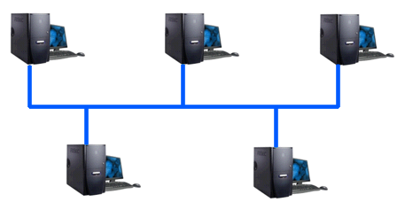

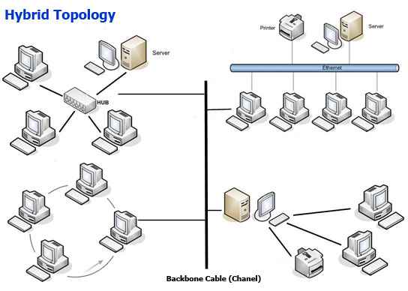
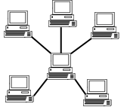
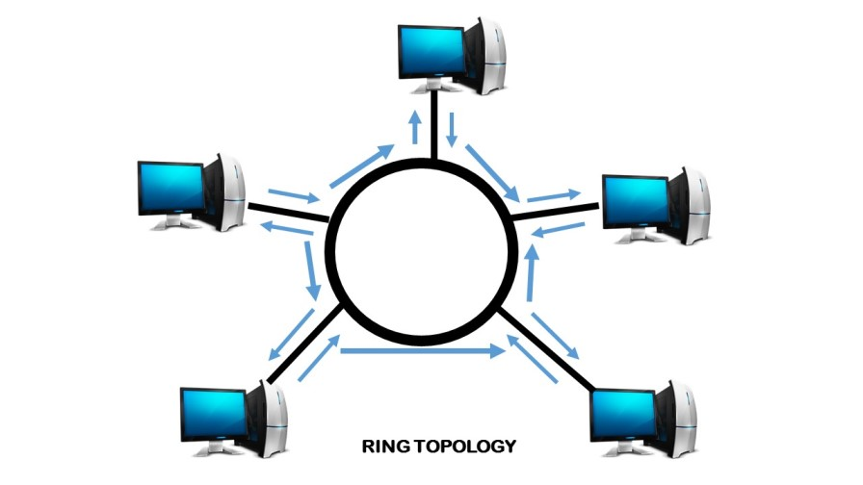
Network Topologies
Point–To-Point
Bus Topology
Mesh Topology
Star Topology
Ring Topology
Hybrid Topology

Slide 30
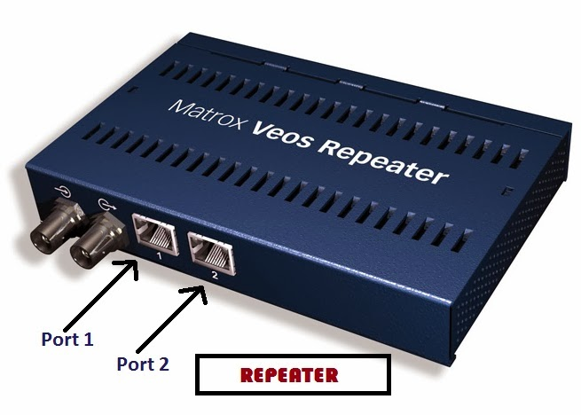
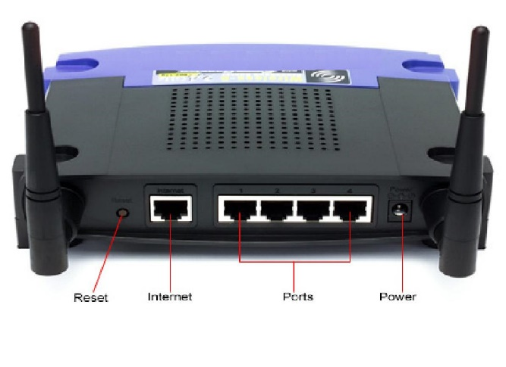
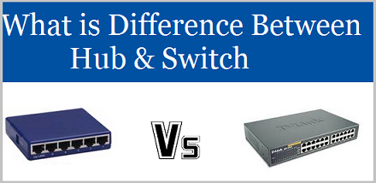
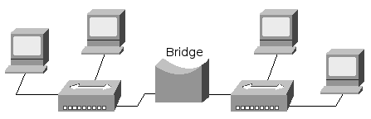
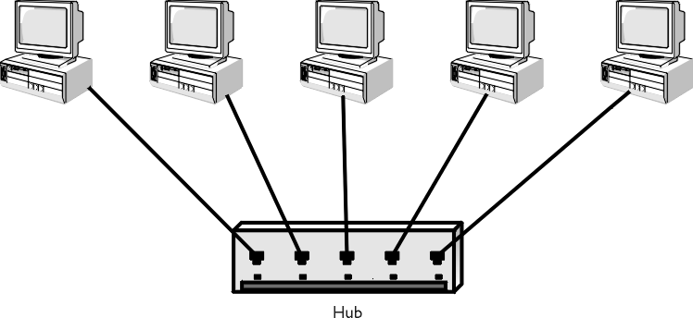
Network Devices
It is used to connect computers or other electronic devices together so that they can share files or resources.
Router
Switch
Repeater
Hub
Bridge

Slide 31
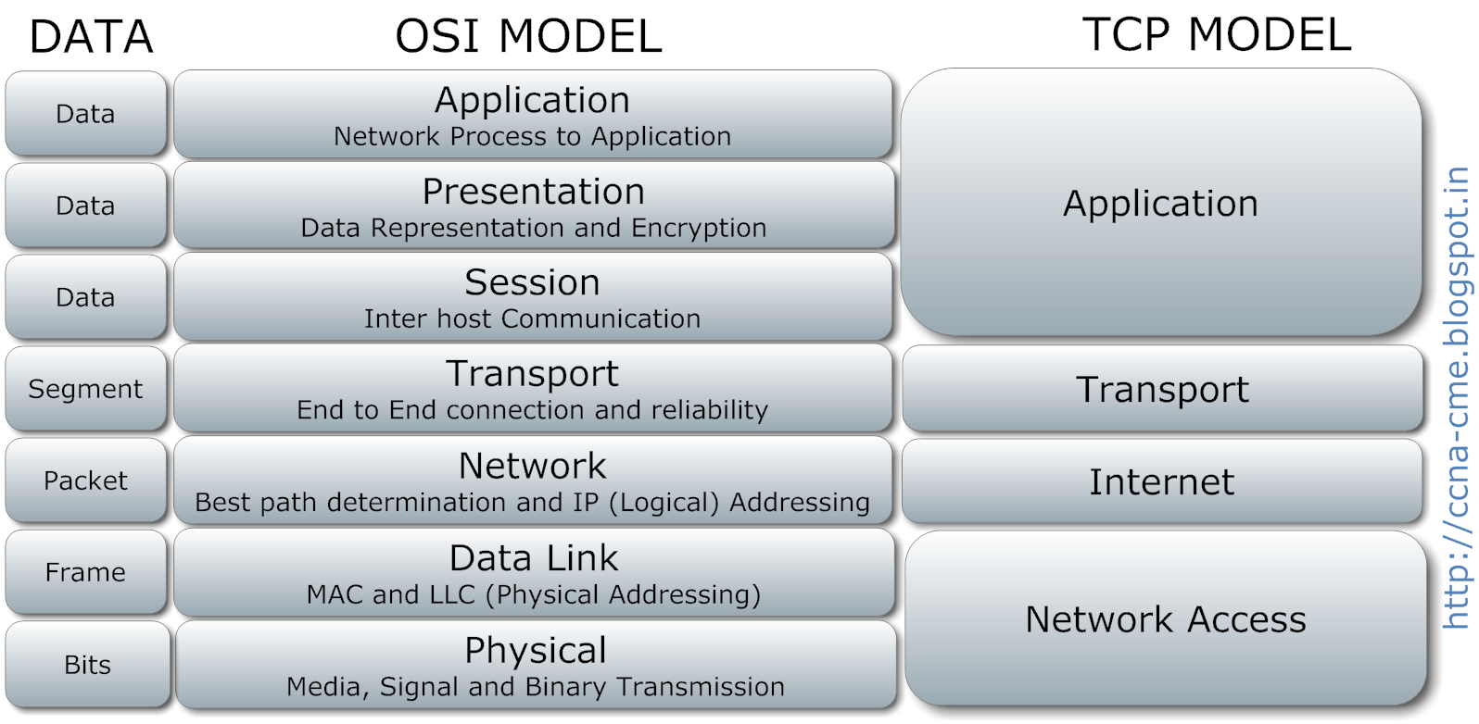
Complete OSI layer Protocol

Slide 32
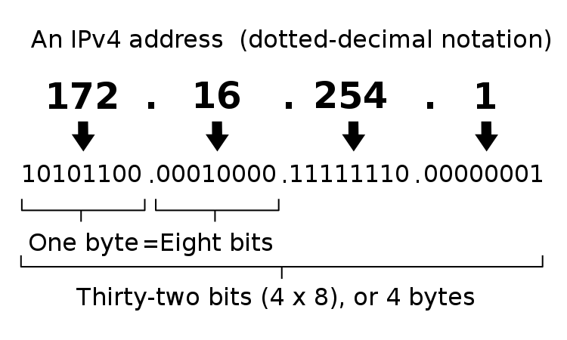
IP Addressing
An Internet Protocol address (IP address) is a numerical label assigned to each device connected to a computer network that uses the Internet Protocol for communication.
IPv4

Slide 33
IPv6
The 128 bit IPV6 address is written as Eight 16 bit integer.(Using decimal digits foe each integer)
Ex: CEDF : BF76 : 0000 : 0000 : 009E : FACE : 3025 : DF12
1100 1110 1101 1111 : 1011 1111 0111 0110 : 0000 0000 0000 0000 : 0000 0000 0000 0000 : 0000 0000 1001 1110 : 1111 1010 1100 1110 : 0011 0000 0010 0101 : 1101 1111 0001 0010
Abbreviations of leading Zeros:
CEDF : BF76 : 0 : 0 : 9E : FACE : 3025 : DF12
“ 0000 : 0000” can be written as “ :: ”
CEDF : BF76 : : 9E : FACE : 3025 : DF12
SLIDE NO: 23

Slide 34
Subnetting:
Subnetting is a way of splitting a network into smaller, more manageable pieces.
purpose of subnetting is to help relieve network congestion.
Reserved Address
Link-local Addresses
169.254.1.0 to 169.254.254.255
Loopback IP Addresses
127.0.0.1 to 127.255.255.254
Private IP Address
10.0.0.0 to 10.255.255.255.
172.16.0.0 to 172.31.255.255.
192.168.0.0 to 192.168.255.255.

Slide 35
NETWORK SERVICES

Slide 36
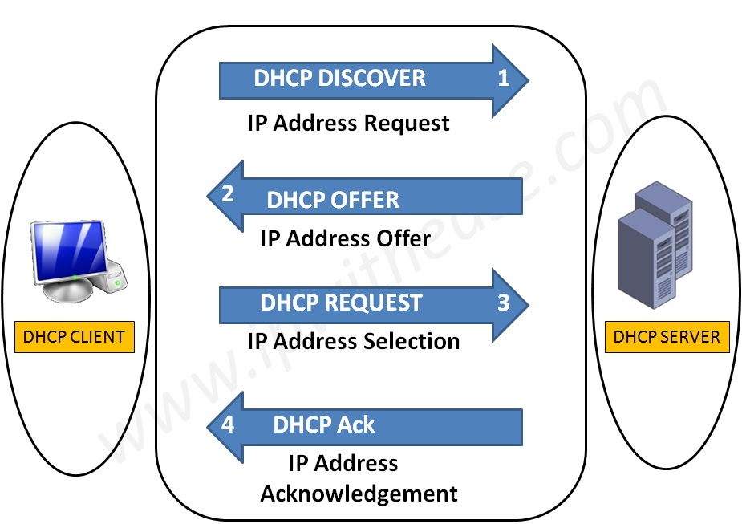
What is DHCP?
Logical Address
Used to dynamically assign an IP address to any node
DHCP Allocation Mechanism:
Manual allocation
Automatic allocation
Dynamic allocation
ARP
Physical Address
Logical Address
RARP
Physical Address

Slide 37
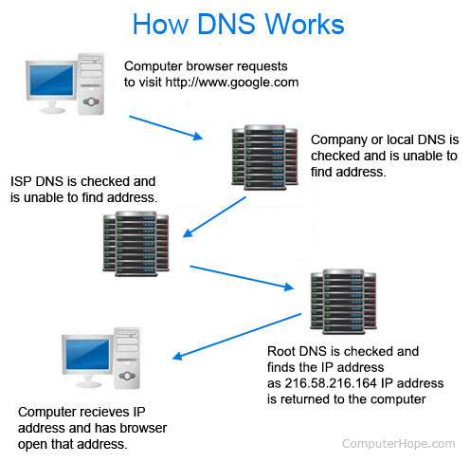
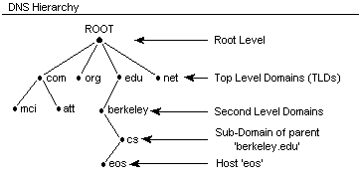
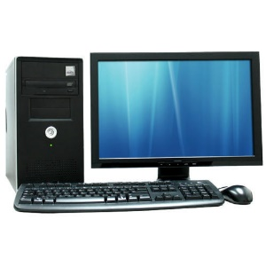
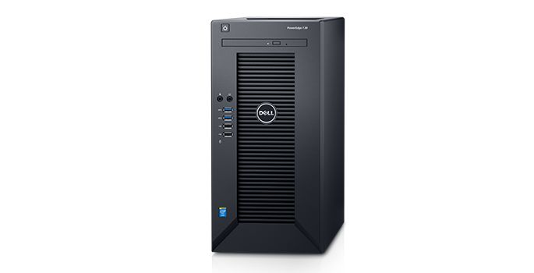

DNS
It converts a computer's host name into an IP address on the Internet.
What is ip of xyz.com
Client
Here is 156.x.x.x
Server
DNS CACHE
OS cache

Slide 38

LDAP (Lightweight Directory Access Protocol)
Lightweight Directory Access Protocol uses client-server architecture.
Directory services contain data and metadata.
X.500 formed the basis of a standard that is widely deployed known as LDAP.
ID | Name | Email
1 | John Doe | a@xyz.com
dc=org, dc=com
ou=finance
ou=eng
Cn=Sam Carter
Cn=Harry Milter

Slide 39



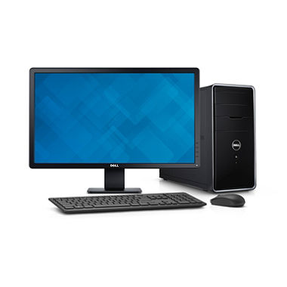

Mail Services
Mail Delivery Agent (MDA)
SMTP
SMTP
SMTP
Internet/Intranet
Mail Transfer Agent (MTA)
Mail Transfer Agent (MTA)
Pop / IMAP
Mail User Agent (MUA)
Mail User Agent (MUA)

Slide 40




Proxy Server
Proxy Caching
Acts as an intermediary between the user's computer and the Internet.
Forward and Reverse Proxy are two types of proxy server.
Proxy Server
www.abc.com
Document Request
Up to Date
Document sent from cache
www.abc.com
CLIENT
CLIENT
ISP
Remote Server
Proxy Server
CACHE

Slide 41
DATABASE FUNDAMENTALS

Slide 42
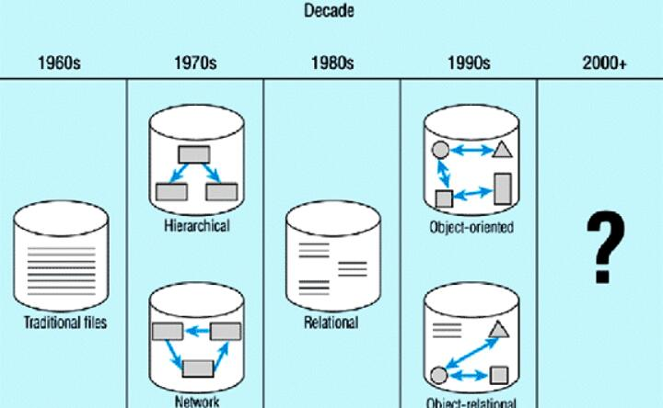
DATABASE
A database is a collection of information that is organized so that it can be easily accessed, managed and updated.

Slide 43
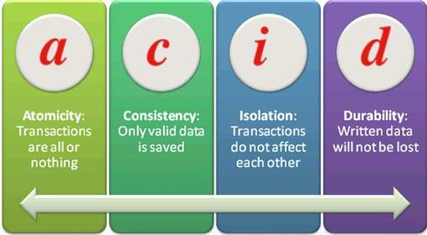
ACID PROPERTIES
Types of keys:
Super Key
Candidate key
Primary key
Secondary key
Composite key
Foreign key

Slide 44
EF CODD RULES
Codd's rules refers to a set of 13 database management system rules (0-12) developed by E.F. Codd in 1969-1970.
Foundation rule
Rule 12 | Rule of subversion
Rule 0 | Foundation rule
Integrity rule
Rule 3 | Rule of systematic null value support
Rule 10 | Rule of integrity independence
Structural rule
Rule 1 | Rule of information
Rule 6 | Rule of updating views
Data Independence rule
Rule 8 | Rule of physical data independence
Rule 9 | Rule of logical data independence
Rule11 | Rule of distribution independence
Data Manipulation rule
Rule 2 | Rule of guaranteed access
Rule 4 | Rule of active and online relational catalog
Rule 5 | Rule of comprehensive data sub-language

Slide 45
TERMINOLOGIES
Attribute
Entity
EMPLOYEE
EMP_NUM | EMP_NAME | JOB_CLASS | CHG_HOUR
103 | June E Arbough | Elect. Engineer | 84.5
114 | Annelise Jones | Applications Designer | 48.1
118 | James J Frommer | General Support | 18.36
Cardinality=3
Tuple
Degree=4
Entity :It is a name about which data can be stored.
Attribute : Attribute refers to a database component.
Tuple : A tuple is one record (one row).
Cardinality : Number of rows
Degree : Number of columns
ss

Slide 46
Need of Normalization
Data anomaly
There are three types of Anomalies
1. Insert
2. Update
3. Delete
Functional Dependency
A-> B means for every value of A there is only one value of B.
Types of Functional Dependency
Fully Functional Dependency
Partially Functional Dependency
Transitive Dependency
PROJ_NUM | PROJ_NAME | EMP_NUM | EMP_NAME
15 | Evergreen | 103 | June E Arbough
 |  | 114 | Annelise Jones
18 | Amber Wave | 114 | Annelise Jones
 |  | 118 | James J Frommer

Slide 47
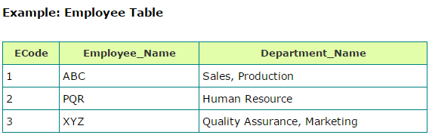



Normalization
Second Normal Form:
A relation is in Second Normal Form , If it is in First Normal Form and has no Partial Dependencies.
1 Normal Form: A relation is in First Normal Form if,
All data stored in the columns of the relation are atomic
No repeating Groups
Third Normal Form:
A relation is said to be in Third Normal Form , if it is in Second Normal Form and all Transitive Dependencies are removed.
Ecode | Employee_Name | Department_Name
1 | ABC | Sales
2 | PQR | Human Resource
3 | LMN | Marketing
Input
Output
Eid | Ename | DOB | Zip | City | State
001 | ABC | 10/05/1990 | 411038 | Pune | Maharastra
002 | XYZ | 11/05/1988 | 400007 | Mumbai | Maharastra
Multiple values
Ecode | Employee_Name
1 | ABC
2 | PQR
3 | LMN
Ecode | Department_Name
1 | Sales
2 | Human Resource
3 | Marketing
Atomic Values

Slide 48

SQL
RDBMS Architecture
Joins, Index, Views
Datatypes
Commands in sql
Application layer
Logical layer
Physical layer

Slide 49
APPLICATION

Slide 50

Introduction
Application is a program designed to perform a group of coordinated functions, tasks, or activities for the benefit of the user
Components of Application
Life Cycle of Application
Presentation Layer
Presentation Logic
Business Processing Layer
Business Logic
Data Storage and Access
Data Persistence

Slide 51
Application
Application Types
API :
An application program interface (API) is code that allows two software programs to communicate with each other.
Compiled
Interpreted
REQUEST
Types of attacks:
SQL Injection
Cross site scripting
Denial of Service
Buffer Overflows
Session Hijacking
LARGE CORPORATE SITE/SYSTEM
SMARTPHONE APP OR WEBSITE
API
RESPONSE

Slide 52

Application
Architecture Types
Thick Client Architecture
Thin Client Architecture
Rich Internet Architecture

Slide 53
STORAGE

Slide 54


Storage Types
Fibre Channel is a high-speed network technology primarily used to connect computer data storage to servers.
Topologies:

Slide 55
NAS
SAN
DAS
Application
Client
Application
Application
File system
Network
File system
Network
File system
Disk Storage
Disk Storage
Disk Storage
NAS Server
RAID subsystem

Slide 56




RAID:
RAID storage uses multiple disks in order to provide fault tolerance, to improve overall performance, and to increase storage capacity in a system.

Slide 57
Thank You

